Slide 1
Hair loss
Hair loss is associated with strong emotional and psychological consequences.
The two major cause of hair loss are:
A-alopecia androgenetica (called male pattern baldness but sometimes called common baldness because it can affect women also)-----treated by the OTC minoxidil.
B-Alopecia areata----sudden and patchy hair loss -----referral. The cause of alopecia areata remains unknown but it is thought that the problem may be autoimmune in origin.

Slide 2
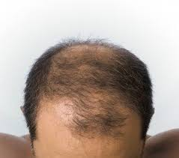
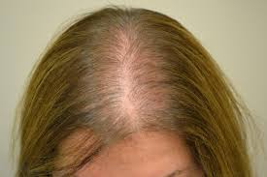
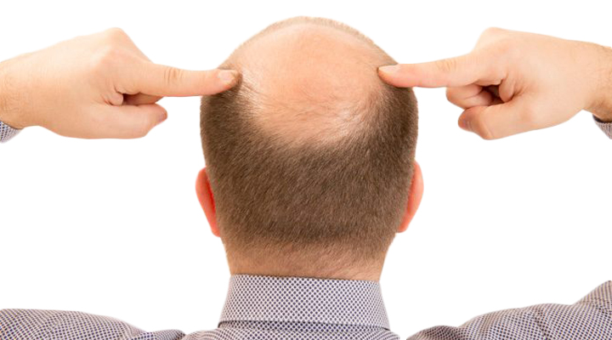

Slide 3
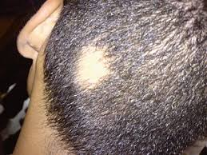

Slide 4
Condition to Eliminate
A-Hypothyroidism----hair loss with coarsening of the hair and associated with recent weight gain, deepening of the voice , feeling of tiredness.
B-hair loss associated with itching and redness of the scalp------may indicate inflammatory scalp condition( e.g. Tinea capitis, psoriasis, …..)------ referral
C-Iron deficiency anaemia could cause diffuse hair loss or aggravate alopecia androgenetica.
Polycystic ovary disease or elevated prolactin levels, which in both cases can result in alopecia androgenetica.

Slide 5
specific events:
During pregnancy (or after childbirth) -----hormonal changes ------hair loss-----the patient should be reassured that this is completely normal and that the hair will grow back-------treatment is not appropriate.
Pregnancy----increased estrogen levels-----hair thickening-----after delivery the hair loss occur to the normal prepregnancy state).

Slide 6
Medication:
A number of drugs can cause hair loss:
1- cytotoxic (almost 100% of them to varying degrees),
2- Anticoagulant (coumarins),
3-Retinoid (in overdose),
4- Oral contraceptive (seen 2 -3 months after stopping),
5- Lipid lowering agents (clofibrate).
6-Other medications include allopurinol, beta-blockers, bromocriptine, carbamazepine, colchicine, lithium and sodium valproate.

Slide 7
Management
A-Minoxidil it available as 2% and 5% lotion
It will take 4 months for any hair regrowth to be seen, and some dermatologists suggest continuing use for 1 year. Hair may continue to fall out for the first two weeks of minoxidil use.
Note: manufacturer advice avoid in hypertension, angina, heart disease, pregnancy, and lactation.

Slide 8
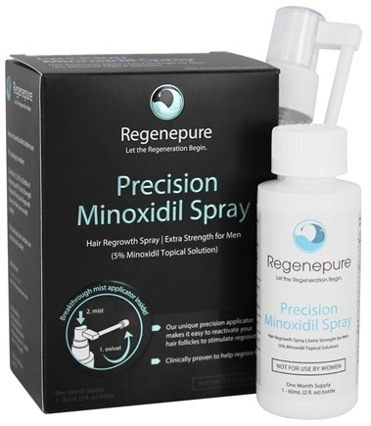

Slide 9
Application:
Apply it to dry scalp and hair. Burb about 1 ml of the lotion or spray to the area of the scalp twice daily. The hair should not be washed for at least 1 hour after using the lotion.
Treatment timescale: 4 months.

Slide 10
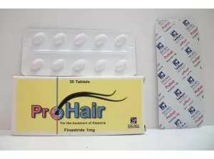
The POM drug finasteride
(Propecia®, prohair, 1 mg tab/day)
Inhibits the enzyme responsible for androgenetic alopecia is used to treat Alopecia Androgenetica in men.

